Slide 1

Library Sort
Group :13
SAMIUL ISLAM SOURAV.
(ID:2031109)
MD Tauhid un-noor konoz.
(ID:2022016)
Sadia Zerin jui.
(ID:2031251)

Slide 2
Introduction of Library Sort
Library sort is known as gapped insertion sort.
It uses an insertion sort, but with gaps in the array to speed up the process for insertions.
The name “Library Sort” comes from an analogy –
“In a bookstore or in a library, there are bookshelves that are to be stored with books in alphabetical order. If a person stores the books without leaving any kind of gapes, then when he needs to store another book that starts with the alphabet “C”, he has to move all the books after the books that start with the alphabet “C” down to “Z”. But if he had stored the books while leaving gap after every section, then he wouldn’t have to move all the books down to the last number. He simply could’ve just stored the book after “C” in the gap.” This is the basic idea and analogy of Library Sort.

Slide 3
History of Library Sort
Library Sort was proposed by Michael A. Bender, Martín Farach-Colton, and Miguel Mosteiro in 2004.
They published a paper in 2006 which is titled as "Insertion Sort is O(nlogn)".
The inventors gave an arbitrary idea of the library sort rather than implementing the code or giving any kind of proper algorithm of the essential parts such as insertion and rebalancing.

Slide 4
Main 3 parts of Library Sort
1.Binary search with gaps | 2.Insertion | 3.Re-balancing
In library sort we have to search a number and the best search for an array is found by binary search. The value of gap which is denoted by epsilon, the range gap is given but it is yet to be implemented. | Insertion is done for logn rounds and the size of the new array is (1 + ε)n. | Re balancing is done after inserting 2^i elements. It accounts cost and time of the library sorting algorithm .

Slide 5
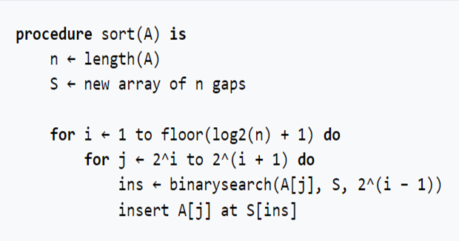
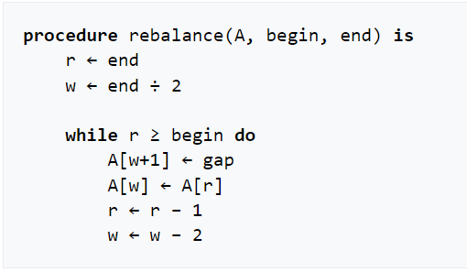
Pseudocode

Slide 6
Complexity Analysis
Worst-case situation → O(n^2).
Best-case situation → O(n log n).
Average-case situation → O(n log n).

Slide 7
Attributes of the Library Sorting Algorithm
Stable
Out Of Place
Offline
Inadaptive
Comparison Based

Slide 8

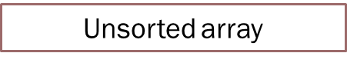
Simulation of Library Sort
1 |  | 2 |  | 5 |  | 10 |  | 12 |  | 15
Sorted array with gap

Slide 9
Index
0 | 1 | 2 | 3 | 4 | 5 | 6 | 7 | 8 | 9 | 10 | 11
1 |  | 2 |  | 5 |  | 10 |  | 12 |  | 15
Sorted array with gaps
Insert Item “2” from the unsorted array

Slide 10
Binary Search
Finding the position of 2 for insertion in the sorted array by using binary search.
1 |  | 2 |  | 5 |  | 10 |  | 12 |  | 15
Finding 2 by using binary search
Gap for the insertion of 2

Slide 11
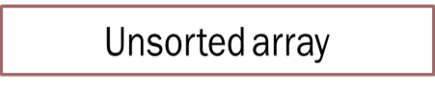
Insertion
Insert element : 2
1 |  | 2 | 2 | 5 |  | 10 |  | 12 |  | 15
2 is inserted

Slide 12
Rebalancing
Insert space between each element :
1 |  | 2 |  | 2 |  | 5 |  | 10 |  | 12 |  | 15
Re –balancing after inserting the element

Slide 13
Index
0 | 1 | 2 | 3 | 4 | 5 | 6 | 7 | 8 | 9 | 10 | 11 | 12 | 13
1 |  | 2 |  | 2 |  | 5 |  | 10 |  | 12 |  | 15
Sorted array with gaps
Insert Item “10” from the unsorted array

Slide 14
Binary Search
Finding the position of 10 for insertion in the sorted array by using binary search.
1 |  | 2 |  | 2 |  | 5 |  | 10 |  | 12 |  | 15
Finding 10 by using binary search
Gap for the insertion of 10

Slide 15
Insertion
Insert element : 10
1 |  | 2 |  | 2 |  | 5 |  | 10 | 10 | 12 |  | 15
1 |  | 2 | 2 | 5 |  | 10 |  | 12 |  | 15
10 is inserted

Slide 16
Rebalancing
Insert space between each element :
1 |  | 2 |  | 2 |  | 5 |  | 10 |  | 10 |  | 12 |  | 15
Re –balancing after inserting the element

Slide 17
Index
0 | 1 | 2 | 3 | 4 | 5 | 6 | 7 | 8 | 9 | 10 | 11 | 12 | 13 | 14
1 |  | 2 |  | 2 |  | 5 |  | 10 |  | 10 |  | 12 |  | 15
Sorted array with gaps
Insert Item “15” from the unsorted array

Slide 18
Binary Search
Finding the position of 15 for insertion in the sorted array by using binary search.
1 |  | 2 |  | 2 |  | 5 |  | 10 |  | 10 |  | 12 |  | 15
Finding 15 by using binary search
Gap for the insertion of 15

Slide 19
Insertion
Insert element : 15
1 |  | 2 |  | 2 |  | 5 |  | 10 |  | 12 |  | 15 | 15
1 |  | 2 | 2 | 5 |  | 10 |  | 12 |  | 15
15 is inserted

Slide 20
Rebalancing
Insert space between each element :
1 |  | 2 |  | 2 |  | 5 |  | 10 |  | 10 |  | 12 |  | 15 |  | 15
Re –balancing after inserting the element

Slide 21
Index
0 | 1 | 2 | 3 | 4 | 5 | 6 | 7 | 8 | 9 | 10 | 11 | 12 | 13 | 14 | 15 | 16 | 17
1 |  | 2 |  | 2 |  | 5 |  | 10 |  | 10 |  | 12 |  | 15 |  | 15
Sorted array with gaps
Insert Item “5” from the unsorted array

Slide 22
Binary Search
Finding the position of 5 for insertion in the sorted array by using binary search.
1 |  | 2 |  | 2 |  | 5 |  | 10 |  | 10 |  | 12 |  | 15
Finding 5 by using binary search
Gap for the insertion of 5

Slide 23
Insertion
Insert element : 5
1 |  | 2 |  | 2 |  | 5 | 5 |  | 10 |  | 10 |  | 12 |  | 15 |  | 15
5 is inserted

Slide 24
Rebalancing
Insert space between each element :
1 |  | 2 |  | 2 |  | 5 |  | 5 |  | 10 |  | 10 |  | 12 |  | 15 |  | 15
Re –balancing after inserting the element

Slide 25
Final Output
Previous Array:
1 |  | 2 |  | 5 |  | 10 |  | 12 |  | 15
Unsorted array:
After Using Library Sorting:
1 |  | 2 |  | 2 |  | 5 |  | 5 |  | 10 |  | 10 |  | 12 |  | 15 |  | 15

Slide 26
Pros and Cons
Pros | Cons
1) It has a high probability of running time of O(nlogn) since it uses Binary search to find the position of insertion. | 1) It requires additional space for the gaps and the total number and distribution of that space is implementation dependent.
2) It does not require a high number of swap operations comparing to insertion sort. | 2) It requires extra cost and memory.
3) It outperforms traditional Insertion sort. | 3) If the data set is large, then each insertion from a random data set will require extra memory that is no longer in cache.

Slide 27

Practical Use
To store books in alphabetical order on a bookshelf.

